Slide 1

Stock Analysis
By
Kishore.PG

Slide 2
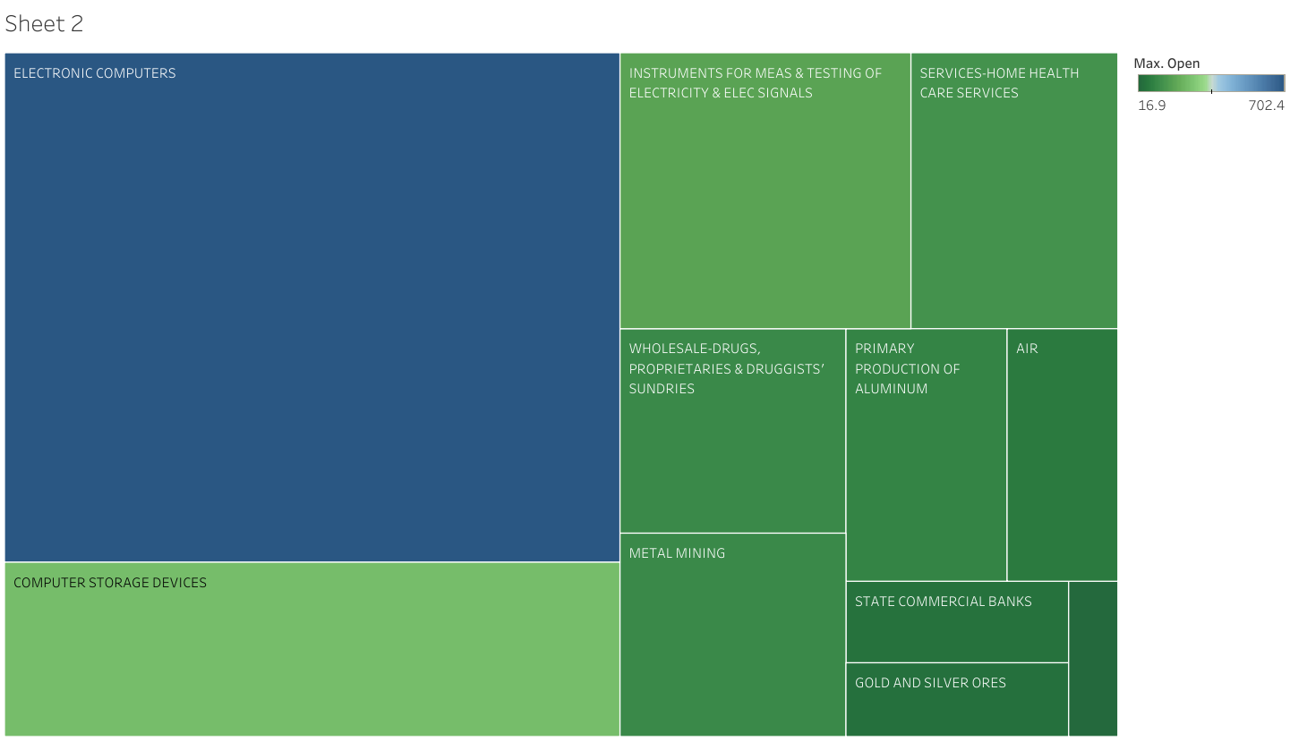
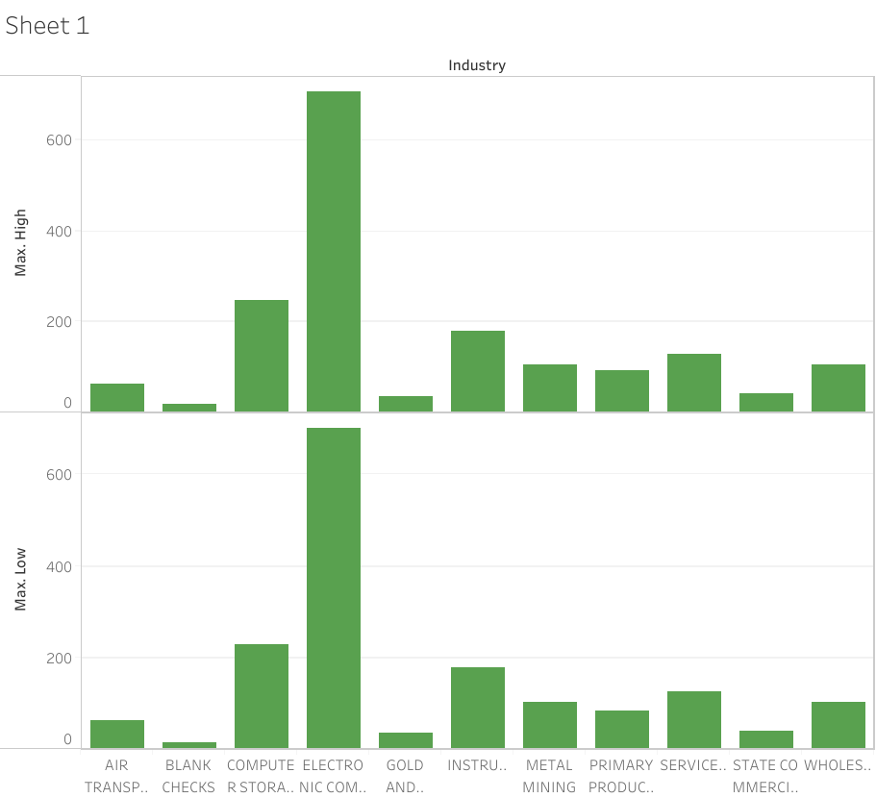
INDUSTRY WISE GROWTH RATE

Slide 3
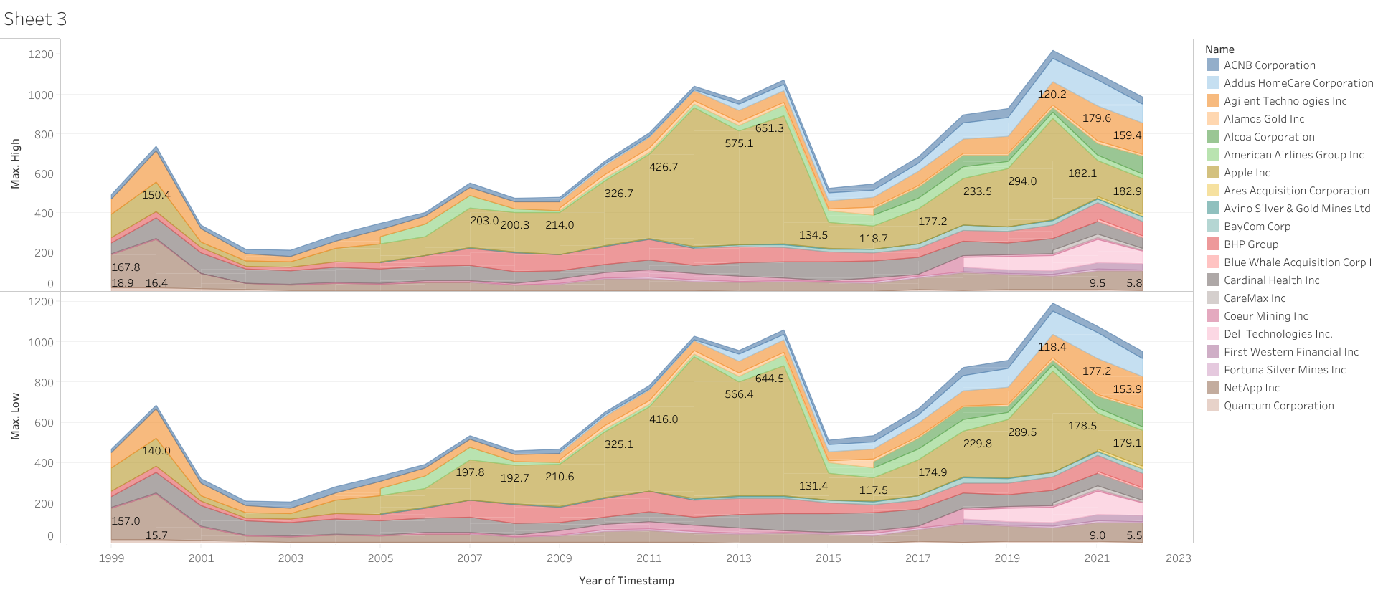
COMPANY TRADE W.R.T YEAR (HIGH AND LOW)

Slide 4
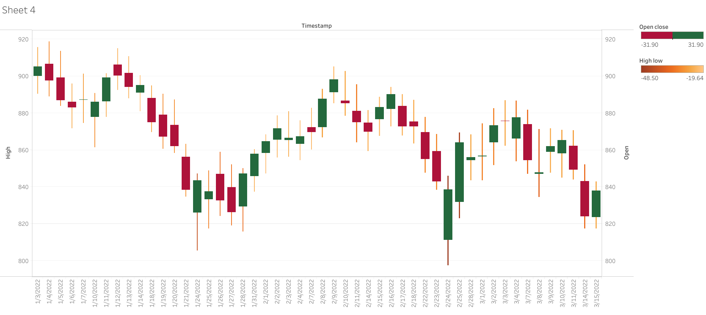
FLUCTUATION RATE (LAST 3 MONTHS)

Slide 5
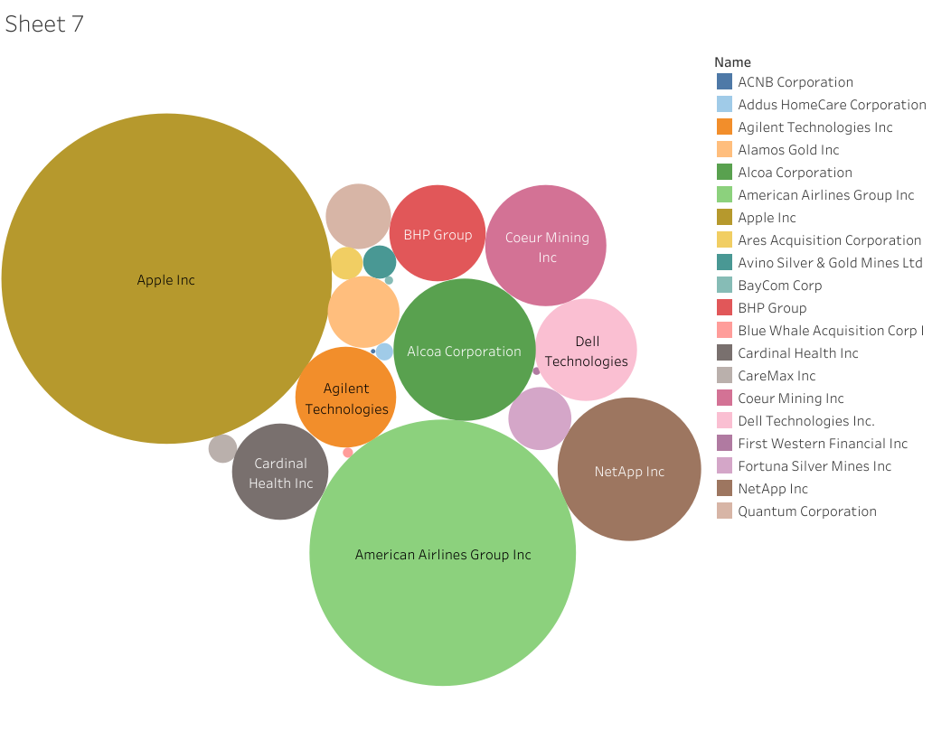
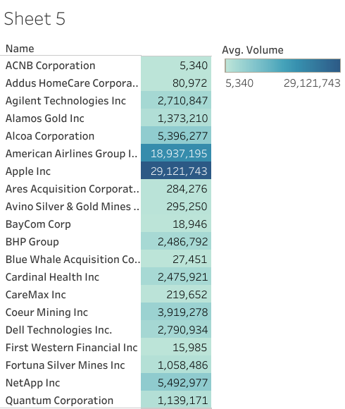
COMPANY’S AVERAGE VOLUME

Slide 6
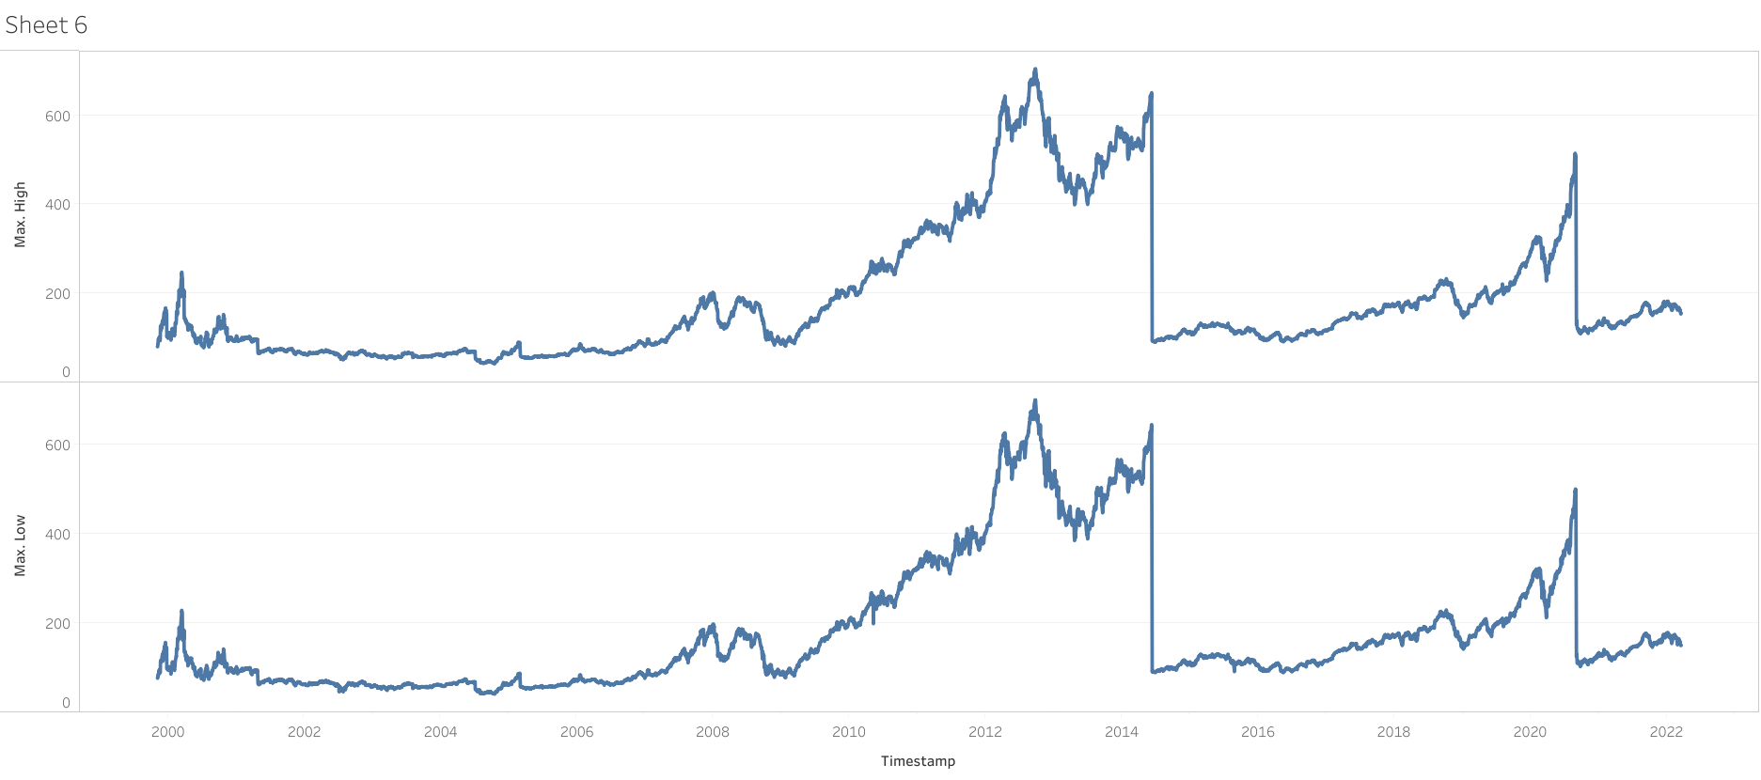
DAY WISE FLUCTUATION RATE

Slide 7
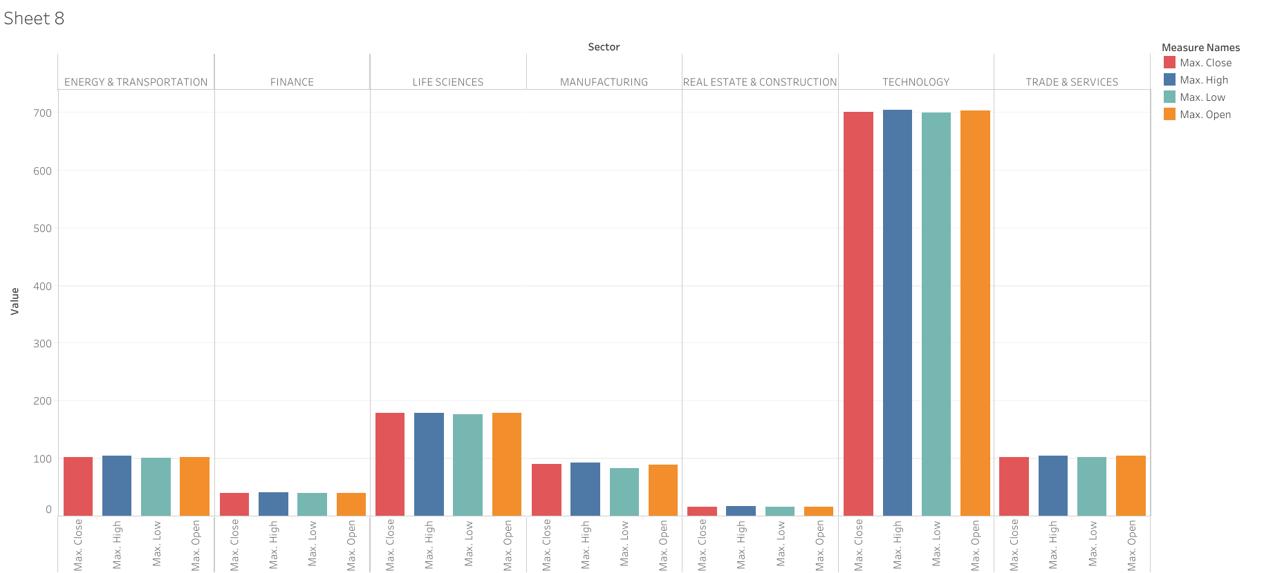
SECTOR BASED TRADE

Slide 8
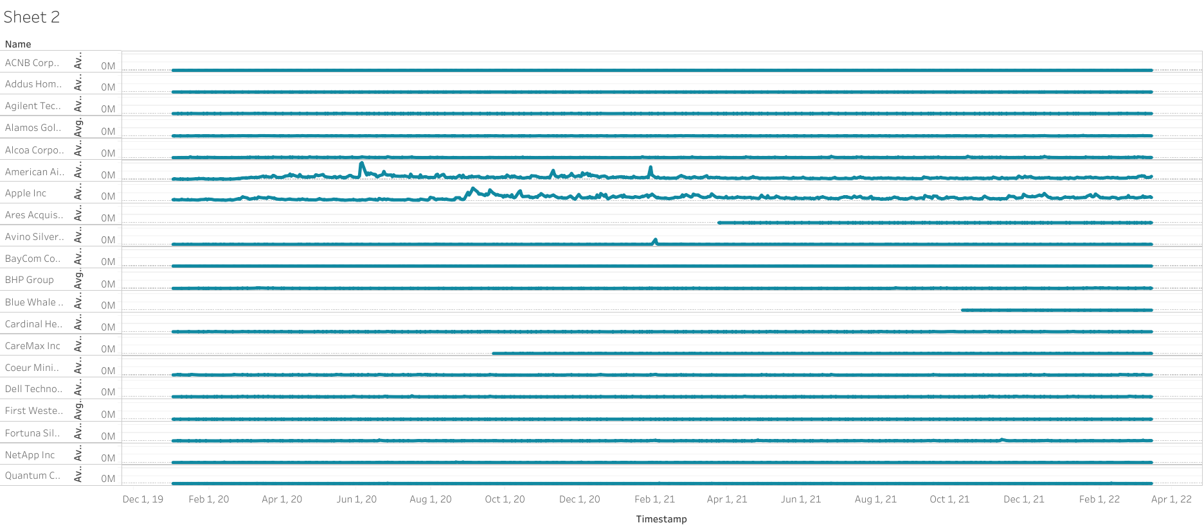
LAST 3 YEARS TRADE OF EACH COMPANIES

Slide 9
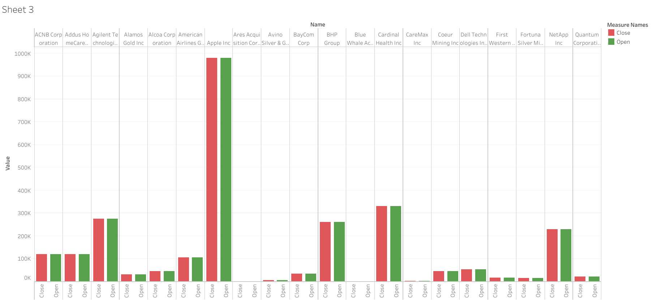
DAY TO DAY STOCK ANALYSIS(OPEN & CLOSE)

Slide 10
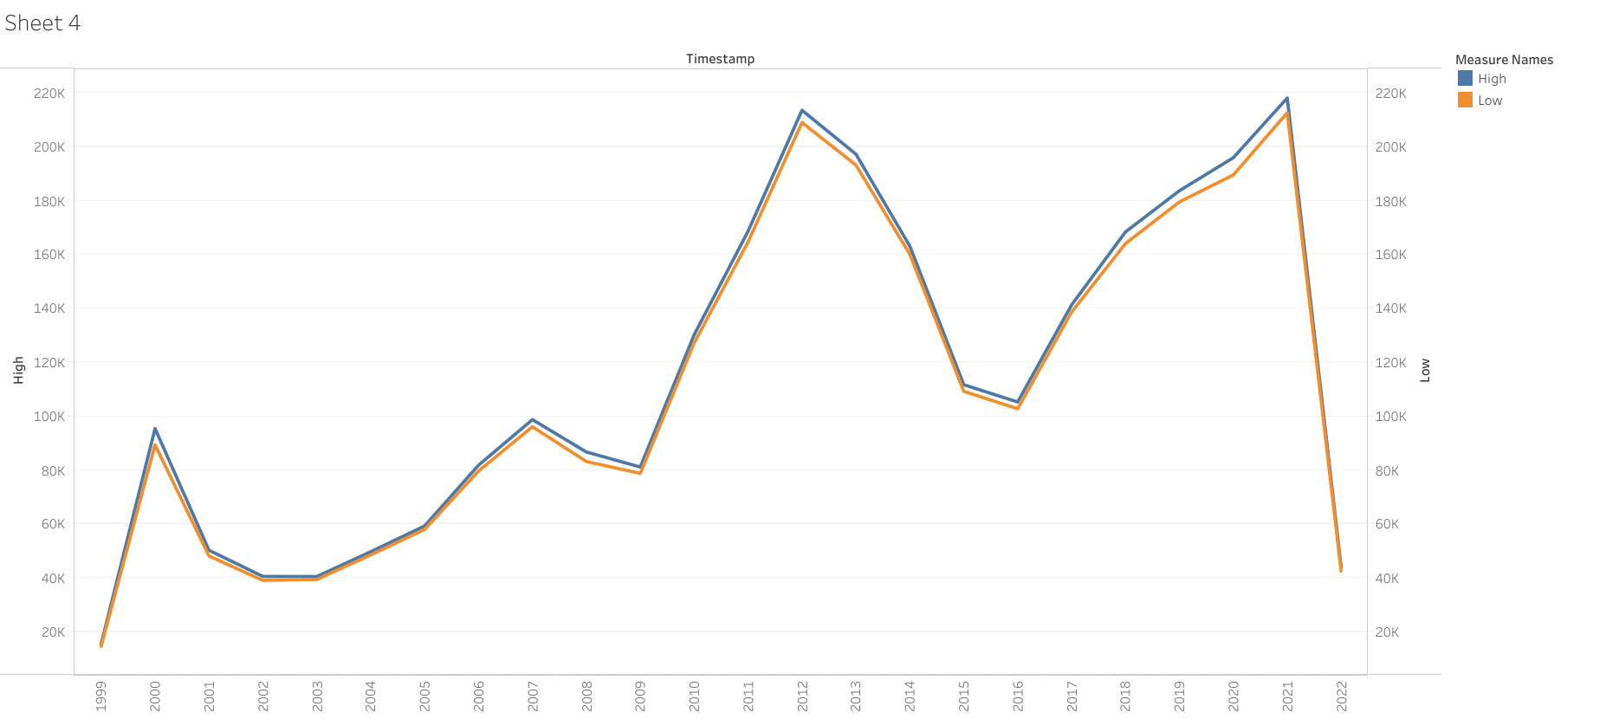
OVERALL STOCK RATE FLUCTUATION OVER THE YEARS

Slide 11

Thank you

